Slide 1


GNR - 602 COURSE PROJECT
Implement a Support Vector Machine classifier (classes > 2) and compare the results of one versus one and one versus rest methods.
Submitted to :-
Presented by:-
Prof. B. Krishna Mohan
22M0303 : Mohit Panwar
22M0312 : Ajinkya Rajendra Dewalkar
22M0316 : Piyush Ashokrao Kene

Slide 2
Problem Statement :-
Not all classification predictive models support multi-class classification.
Algorithms such as the Perceptron, Logistic Regression were designed for binary classification and do not natively support classification tasks with more than two classes.

Slide 3
Approach:-
One approach is to split the multi-class classification dataset into multiple binary classification datasets and fit a binary classification model on each.
Two approach of SVM are One-vs-One and One-vs-Rest strategies.
Kernel Function is used to transforms the training set of data so that a non-linear decision surface is able to transform to a linear equation in a higher dimension spaces.

Slide 4
One Vs One Approach :-
The One-vs-One strategy splits a multi-class classification into one binary classification problem per each pair of classes.
N*(N-1)/2 number of SVMs needed.
For example, for 4 classes: ‘red,’ ‘blue,’ and ‘green,’ ‘yellow.’ This could be divided into six binary classification datasets: red vs. blue, red vs. green, red vs. yellow, blue vs. green, blue vs. yellow, green vs. yellow.

Slide 5
One Vs Rest Approach :-
The One-vs-Rest strategy splits a multi-class classification into one binary classification problem per class.
N number of SVMs needed.
For example, for 3 class ‘red,’ ‘blue,’ and ‘green‘. This could be divided into three binary classification datasets: red vs [blue, green], blue vs [red, green], green vs [red, blue]

Slide 6
Input Data:-
AVIRIS HYPERSPECTRAL DATA
Spectral channels with wavelengths from 400 to 2500 nanometers.
Number of Bands – 220
Radiometric Resolution – 12 bits
Spatial Resolution - 20 m resolution

Slide 7
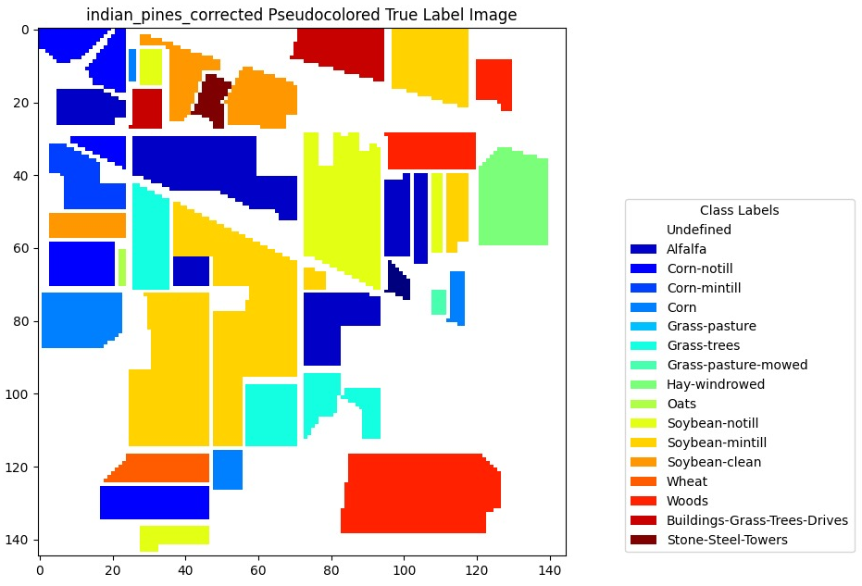
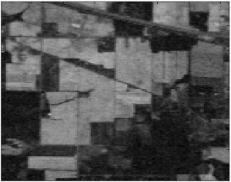
Indian Pines
HYPERSPECTRAL IMAGE
PSEUDOCOLORED IMAGE

Slide 8
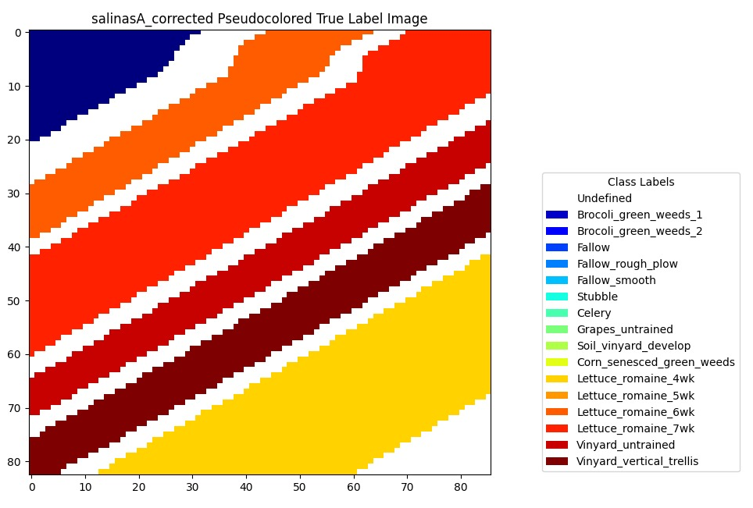
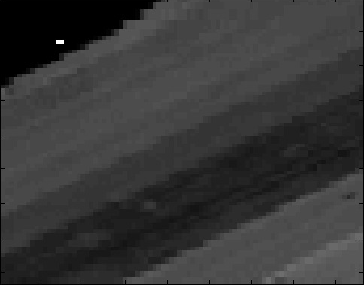
Salinas-A
HYPERSPECTRAL IMAGE
PSEUDOCOLORED IMAGE

Slide 9
Flowchart:-
Input image data file, ground truth data file Kernel and slack value(c)
Display of RGB, Grayscale &pseudo colour image
Splitting of data
Normalization of data
Accuracy report generation
Visualization of classified images
Run OVO and OVR classifier

Slide 10
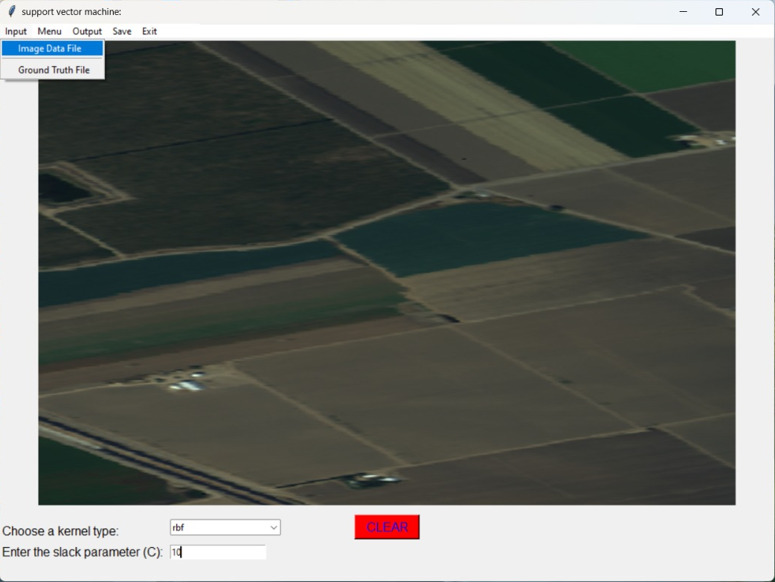
Python based GUI using Tkinter:-

Slide 11
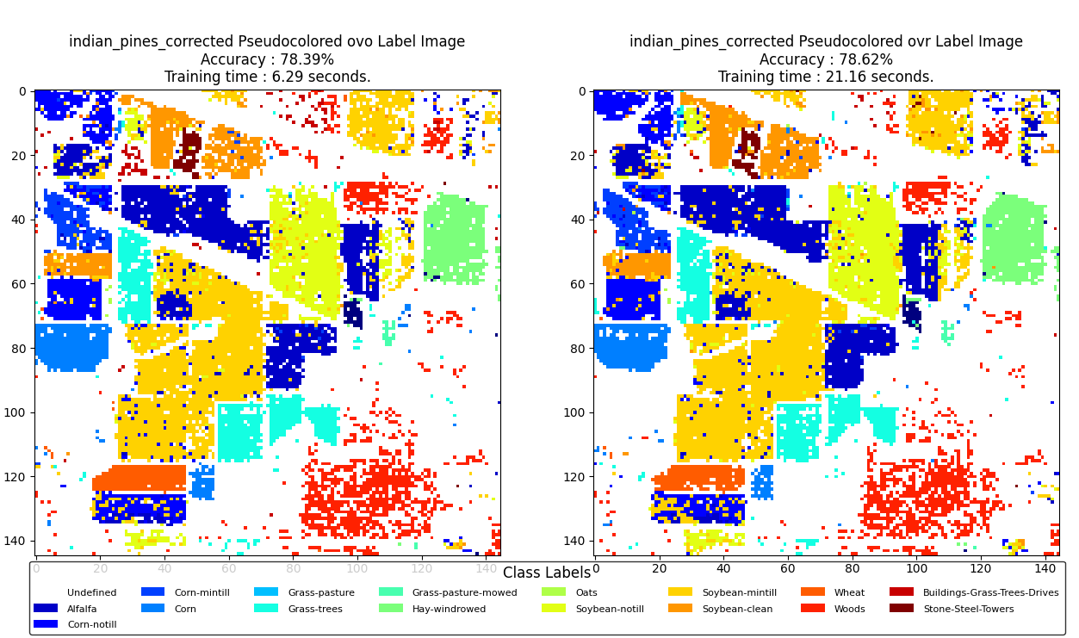
Results:-
Kernel= Polynomial
C=10
Indian Pines image data

Slide 12
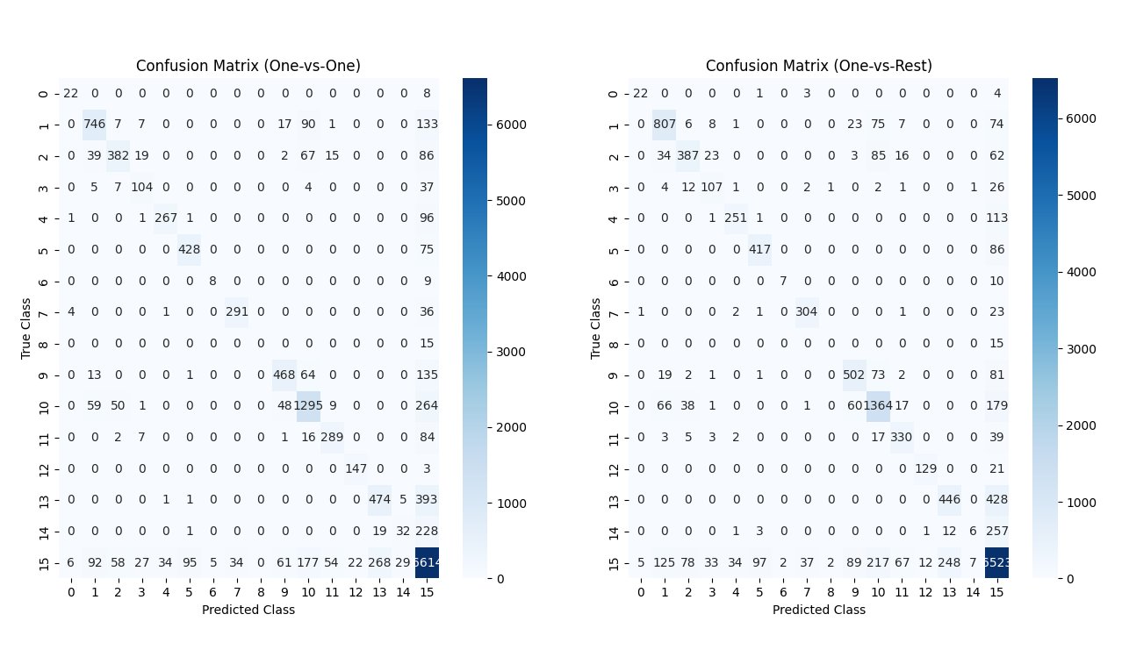
Confusion Matrix

Slide 13
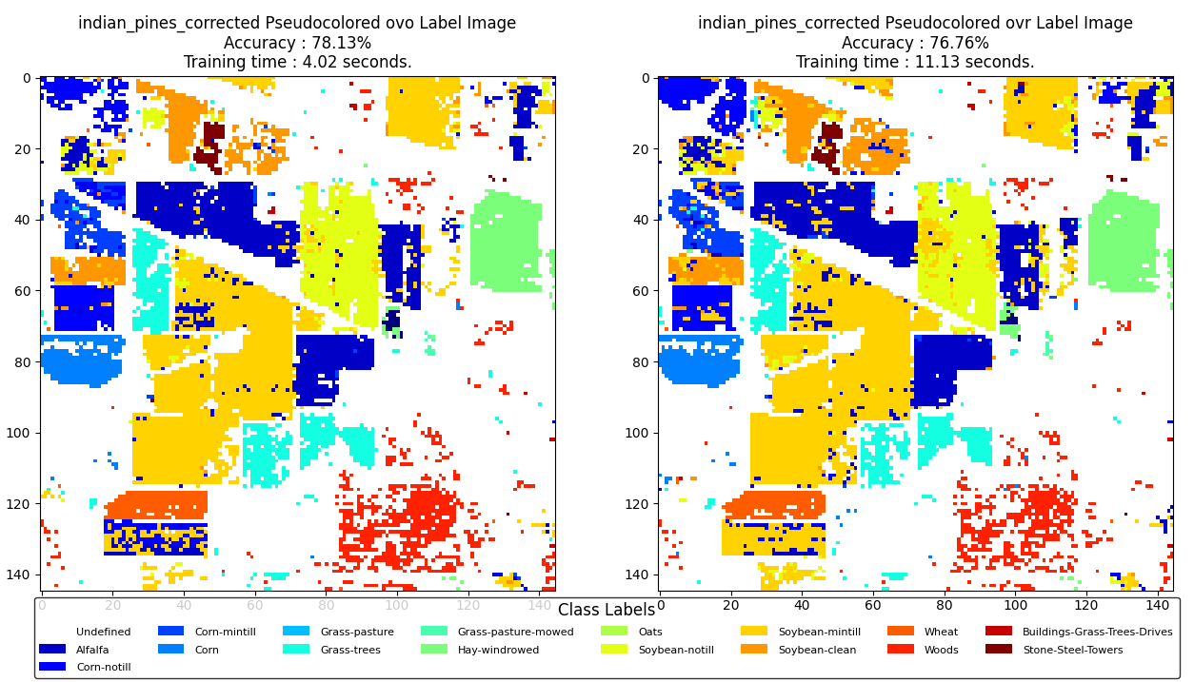
Kernel= RBF
C=10
Indian Pines image data

Slide 14
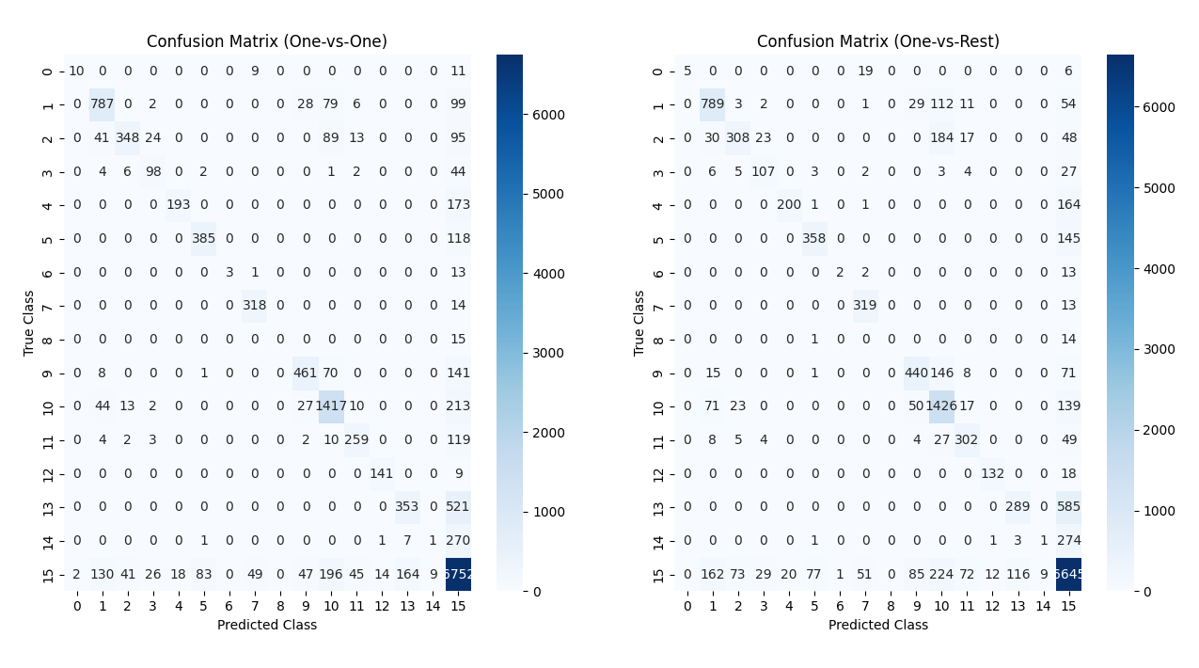
Confusion Matrix

Slide 15
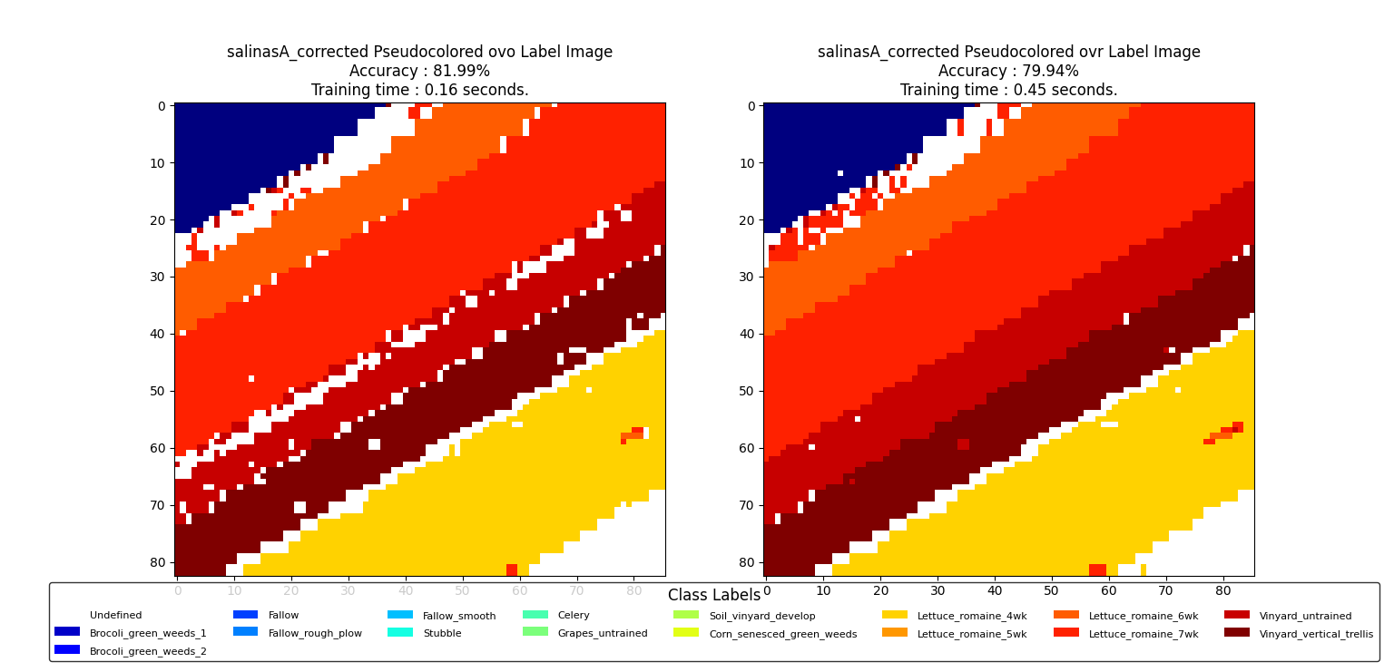
Kernel= Polynomial
C=10
Salinas-A image data

Slide 16
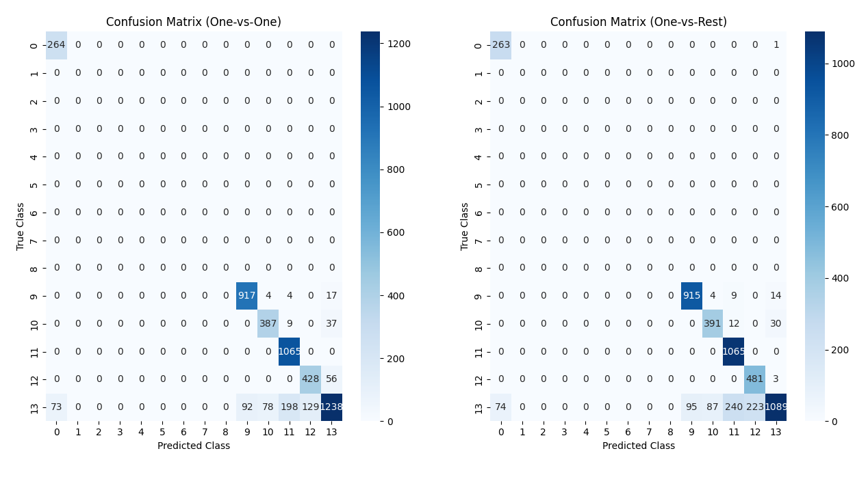
Confusion Matrix

Slide 17
References:-
https://aviris.jpl.nasa.gov/
https://stackoverflow.com/questions/34108841/creating-a-simple-gui-program-using-tkinter-in-python
https://machinelearningmastery.com/one-vs-rest-and-one-vs-one-for-multi-class-classification/
https://www.ehu.eus/ccwintco/index.php/Hyperspectral_Remote_Sensing_Scenes#Salinas_scene

Slide 18
THANK YOU!

